Slide 1
CS 4974 Independent Study
10/10/22 meeting
Student: Bug Lee

Slide 2
Last time, we discussed…
VM initialization
Pushing Global variables to bottom of the stack
Pushing main function stack frame\
Execution cycle
Mov, add, push, call, ret, print

Slide 3
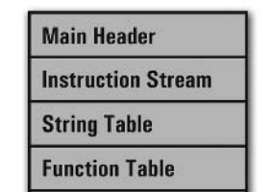
Week 4-6
compiler
assembler
script.source
script.assembly
script.executable
Virtual Machine
CPU

Slide 4
Demo 1: Add

Slide 5
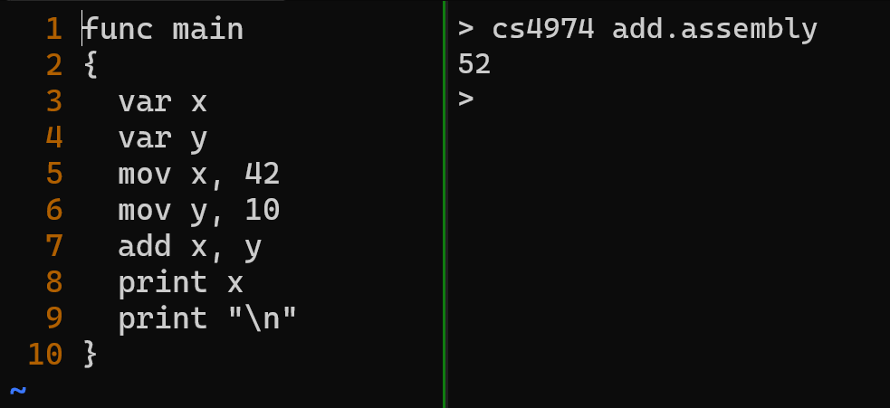

Slide 6
Demo 2: Function call

Slide 7
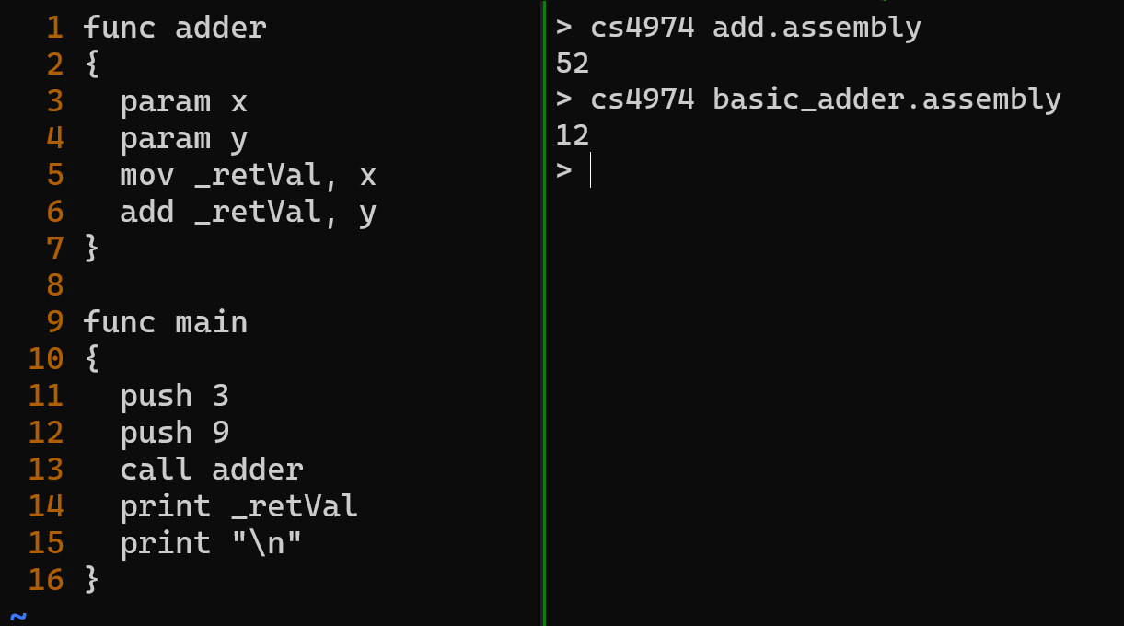

Slide 8
Demo 3:
Nested Function calls

Slide 9
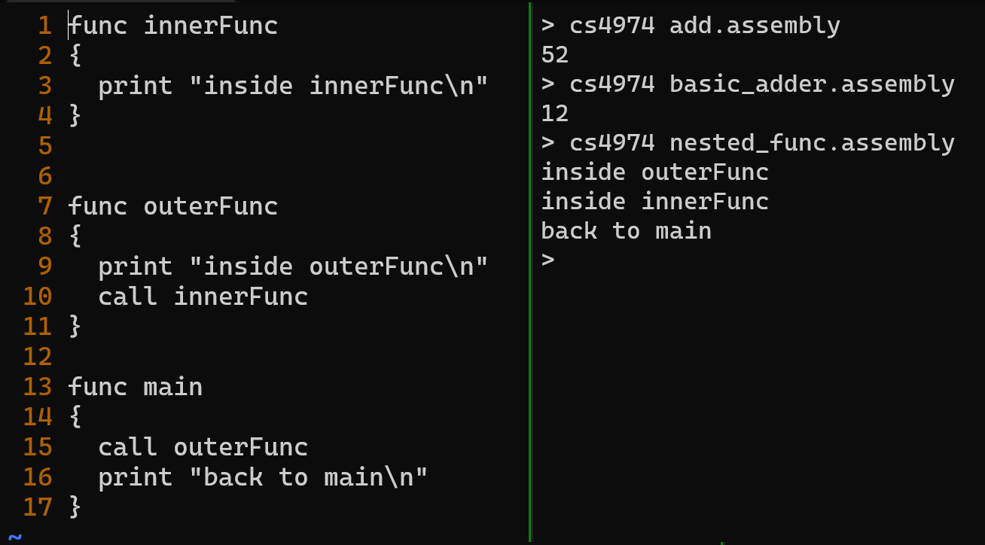

Slide 10
Demo 4: branching

Slide 11
Demo 5:
Command line arguments

Slide 12
Demo 6: Recursion

Slide 13
Demo 7: Sorting

Slide 14
Current limitation of function
Only support pass by value
For sort.casm example code, all elements from array were pushed to stack instead of passing reference

Slide 15
Plan for week 7
Allow script to pass array by reference to function
Start Compiler lexer and parser implementation.

